Slide 1
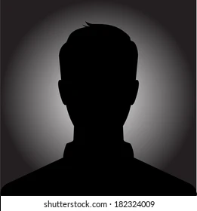
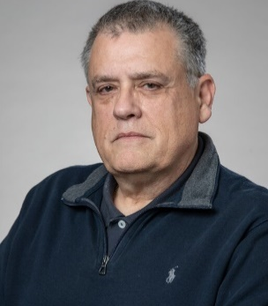



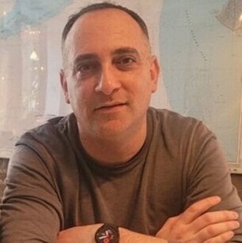
TEAM.
Jonathan
Schwartz
Albert
Hernandez
Jordan
Kesner
Yifei
Li
Kala
Sivasubramanian
Frederik
Tylim

Slide 2
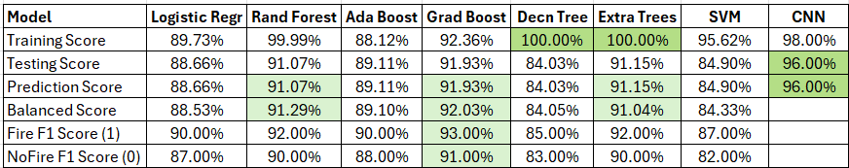
Kala BYO Model
Data Wildfire Prediction Satellite Images
Training images 14,500 no wildfire, 15,750 wildfire
Testing images 2,820 no wildfire, 3,479 wildfire
Validation images 2,820 no wildfire, 3,480 wildfire
Pre-Trained Models
NLP using spaCy and NYT articles via API
Retrieved 10 NYT articles on wildfires – abstracts and lead paragraphs. Most common adjectives: “dry, strong, hard, dangerous, rugged, intense”
Chat using LLM gemini-1.5-flash w/o Conversational Memory Chat using LLM gemini-1.5-flash with Conversational Memory
What are three common causes of wildfire? Ditto
Three common causes of wildfires are:
**Lightning strikes:** Natural ignition sources, …
**Human carelessness:** Discarded cigarettes, …
**Arson:** Deliberately set fires, often for malicious purposes.
What preventive measures should be taken? What preventive measures should be taken?
Depends on *what* you are trying to prevent. I need more context… Preventing wildfires requires a multi-pronged approach, key measures:
Based on wildfire risk, what marketing opportunities exist? **Reducing Ignition Sources:**, * **Responsible Campfire Management:** …
Home improvement, construction, insurance, technology… It's important to remember that wildfire prevention is a shared responsibility….

